Slide 1



Dative database
Elisabeth Kerr
BaSIS brainstorm
Leiden University, Fri 8th Nov 2019
Notes:
10:10-10:40, day 1

Slide 2
Dative database: Outline
1. What is Dative?
2. Dative and BaSIS
3. Hands-on activity
Notes:
2

Slide 3
Notes:
Ask audience who has used Dative before

Slide 4
1. What is Dative?

Slide 5
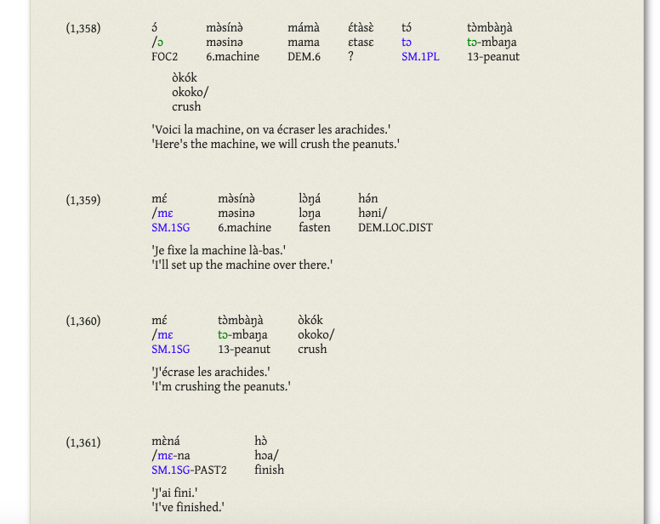
1. Overview
Newly-developed software for linguistic fieldwork
Supports collaboration
A GUI to the OLD
Free, open-source, online
Screenshot of forms in Dative

Slide 6
1. Dative vs FLEx/ELAN
Supports collaboration, online functionality
Manufactured open-source, free
Not time-aligned (but can upload files)
Allows complex search functions
User has control over set-up options

Slide 7
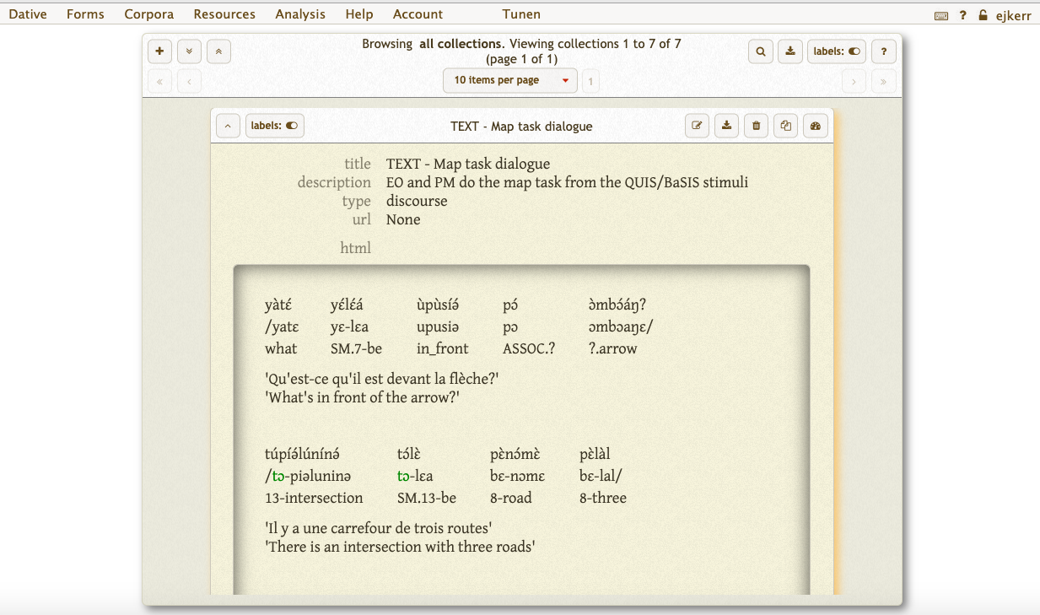
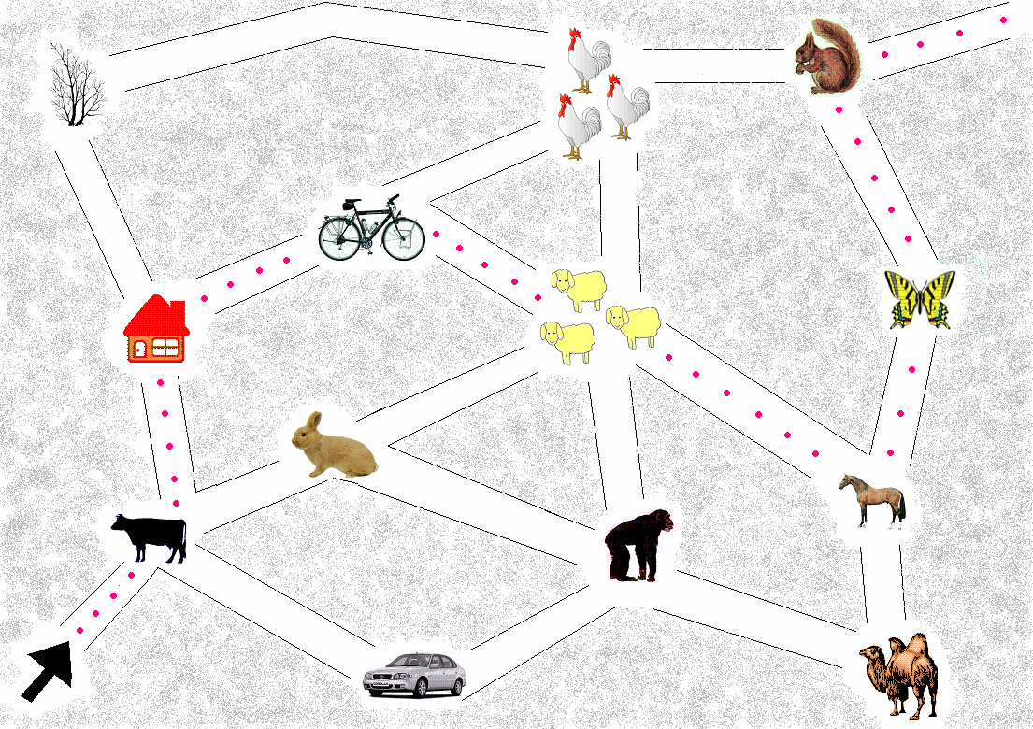
1. Key functionality
Forms
Transcribed utterances
Collections
Collected set of forms,
e.g. the pear story,
the QUIS map task

Slide 8
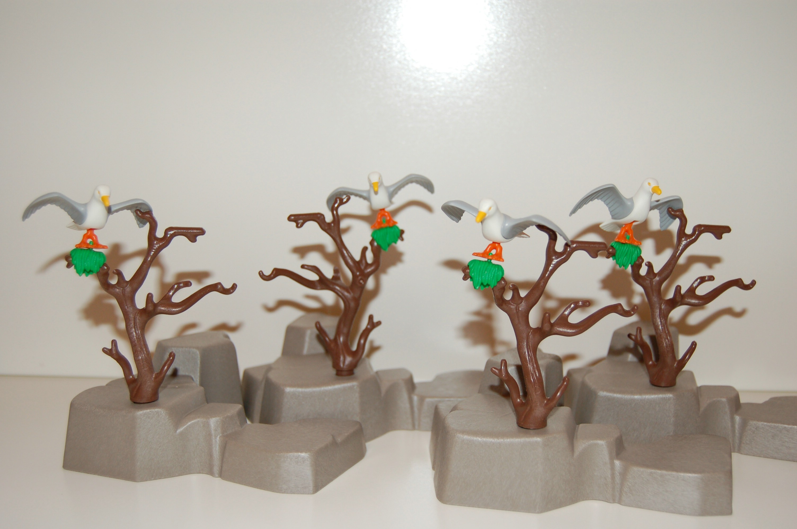
1. Files
Audio/video files can be linked to forms
Can also link images to forms
e.g. for picture stimuli
Files stored on server
Example picture stimulus
(Scope image 002)

Slide 9
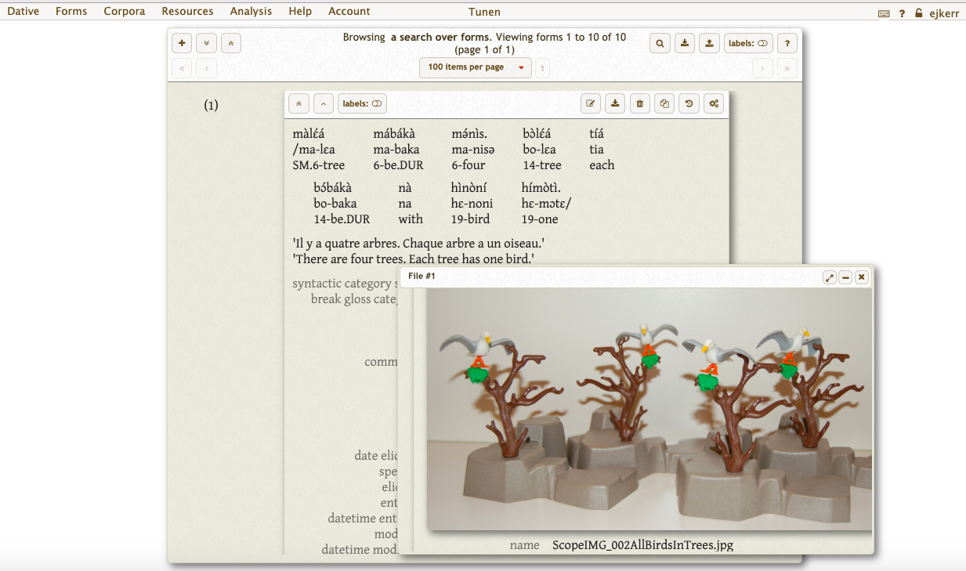
1. Dative
Audio/video files can be linked to forms
But not time-aligned (unlike ELAN)
Can also link images to forms for picture stimuli
Example picture stimulus
(Scope image 002)

Slide 10
2. How BaSIS use Dative

Slide 11
2.1. Set up
1 Dative database for each BaSIS language (connecting to an OLD server)

Slide 12
2.1. Set up
1 Dative database for each BaSIS language (connecting to an OLD server)
Changana
OLD
Copi
OLD
Herero
OLD
Kirundi
OLD
Kiitharaka
OLD
Makhuwa
OLD
Nyakyusa
OLD
Rukiga
OLD
Teke-Kukuya
OLD
Tunen
OLD

Slide 13
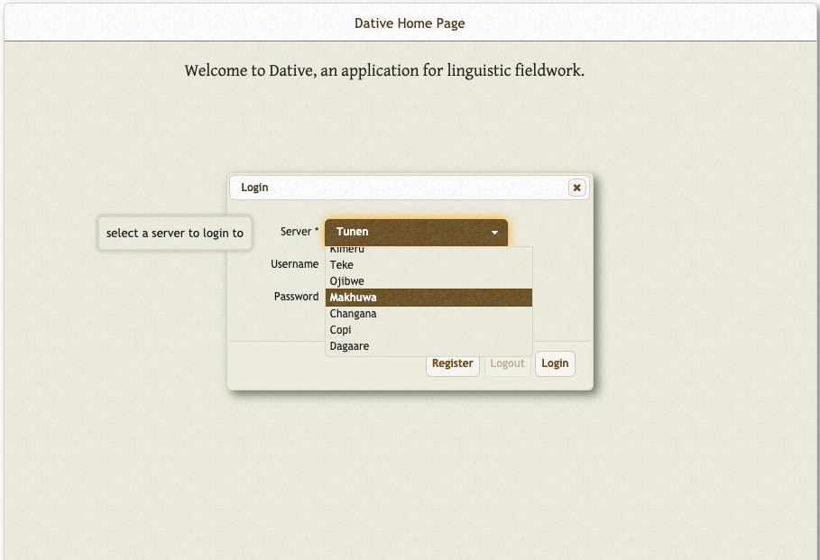
2.1. Set up
1 Dative database for each BaSIS language (connecting to an OLD server)
Changana
OLD
Copi
OLD
Herero
OLD
Kirundi
OLD
Kiitharaka
OLD
Makhuwa
OLD
Nyakyusa
OLD
Rukiga
OLD
Teke-Kukuya
OLD
Tunen
OLD

Slide 14
2.2. Archiving
Each database to be archived at the end of the project
- Dative export (.xml/.csv/LaTeX/JSON/Wordpress plugin)
- Audio/video recordings (raw data)
- Metadata (e.g. sociolinguistic profile of consultants)

Slide 15
2.2. Archiving
Each database to be archived at the end of the project
- Dative export (.xml/.csv/LaTeX/JSON/Wordpress plugin)
- Audio/video recordings (raw data)
- Metadata (e.g. sociolinguistic profile of consultants)
Changana
OLD
Copi
OLD
Herero
OLD
Kirundi
OLD
Kiitharaka
OLD
+ raw data
+ metadata
Makhuwa
OLD
Nyakyusa
OLD
Rukiga
OLD
Teke-Kukuya
OLD
Tunen
OLD
archived at end of project

Slide 16
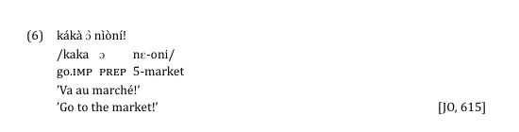
2.3. Citing
In talks/publications:
Dative form id to be cited along with example
= Unique identifier of each transcribed utterance
  U

Slide 17
2.3. Citing
In talks/publications:
Dative form id to be cited along with example
= Unique identifier of each transcribed utterance
  U
form
UID
consultant initials

Slide 18
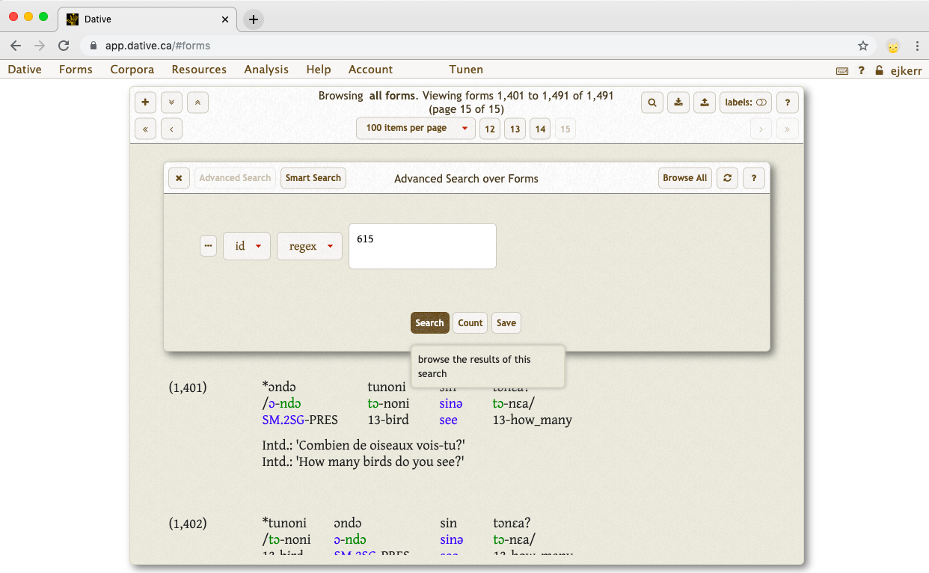
2. BaSIS and Dative

Slide 19
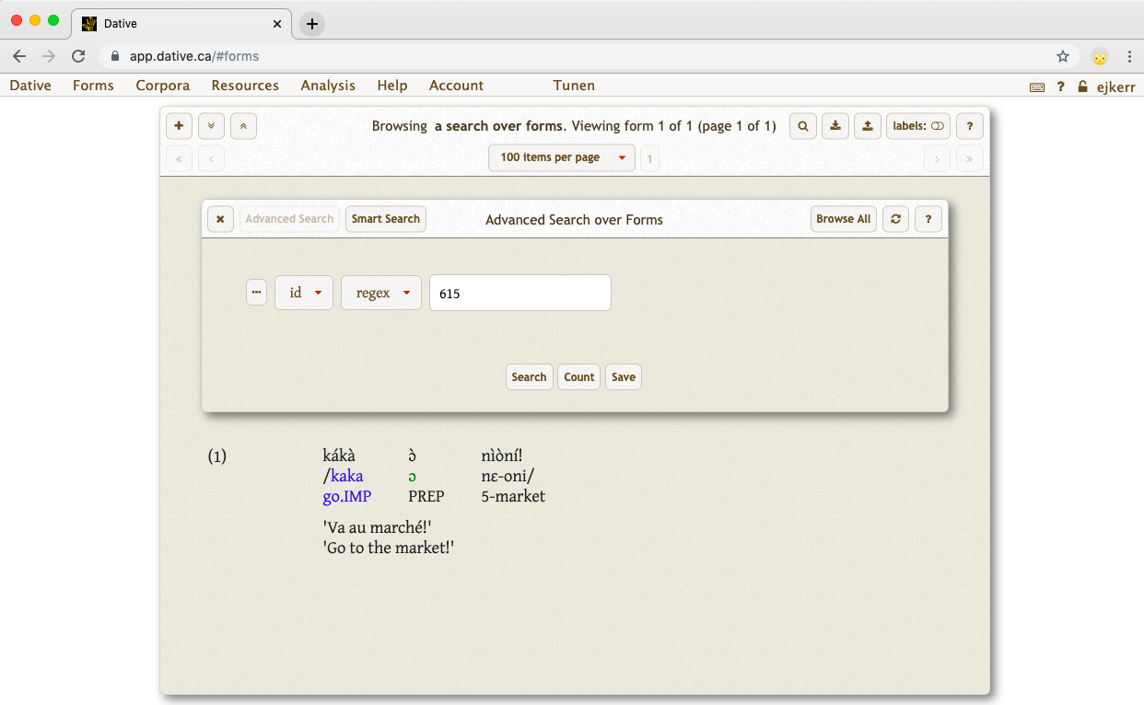
2. BaSIS and Dative

Slide 20
2.4. Analysis
Collections to gather texts
Search function to find examples
Search any field (baseline, tags, translations…)
Conjunction search possible
e.g. Looking for negation in relatives…
  U

Slide 21
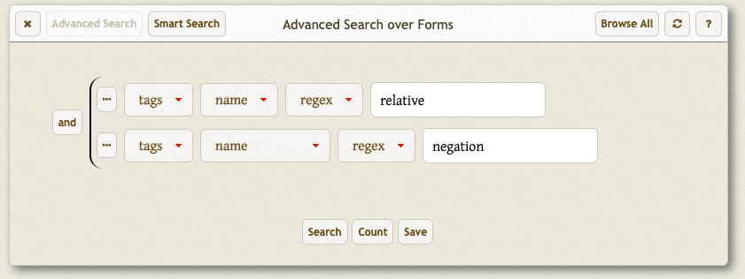
2.4. Analysis
Search function to find examples
Search any field (baseline, tags, translations…)
Conjunction search possible
e.g. Looking for negation in relatives:
  U

Slide 22
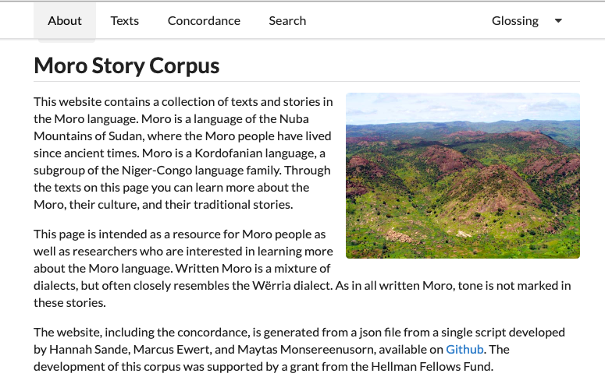
2.5. Possible applications
Moro text project:
(used LingSync;
older form of OLD)
http://linguistics.berkeley.edu/moro/#/
  U

Slide 23
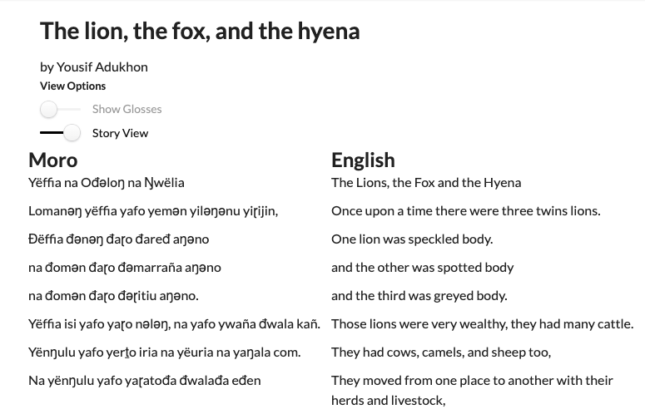
2.5. Possible applications
http://linguistics.berkeley.edu/moro/#/
  U

Slide 24
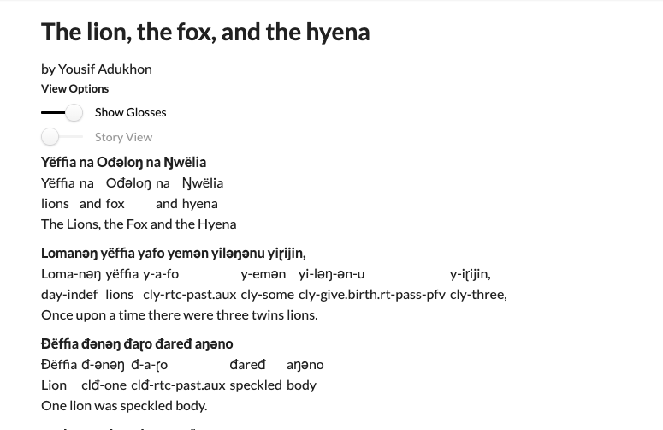
2.5. Possible applications
http://linguistics.berkeley.edu/moro/#/
  U

Slide 25
2.6. Summary
Dative is software for linguistic fieldwork
Good for collaboration
Can link files to forms
Use Collections to group texts
Complex search functions for analysis

Slide 26
Notes:
Ask for any clarification questions before the activity

Slide 27
3. Activity

Slide 28
3. Trying out Dative
Split into 3-4 groups (find someone with a laptop)
Log onto Dative at app.dative.ca
Access the server BaSIS test with the passwords written on the whiteboard/sent over email
  U

Slide 29
3. Trying out Dative
Group Task
Meeussen Input the forms from the fieldnotes given
Guthrie Upload files to forms
Lyons Explore search functions
Chafe Use Collections to investigate reference tracking in discourse
  U

Slide 30
Links
Dative application. Log in to your database here:
app.dative.ca
Dative homepage. Includes documentation and video tutorials:
dative.ca
OLD:
http://www.onlinelinguisticdatabase.org/
Contact me for updates about the offline Dative tutorial.

Slide 31
Picture credits
All links accessed 11/2019.
Dative logo: dative.ca
FLEx logo: https://encrypted-tbn0.gstatic.com/images?q=tbn:ANd9GcS7cOoRzStBJPBHp7udSxisP5yKqYWQQSAFIwohf7S52RPRYauGCQ&s
OLD logo: http://www.onlinelinguisticdatabase.org/
Scope image from Max Planck: https://www.eva.mpg.de/lingua/tools-at-lingboard/material_scope_fieldwork_project.php
Screenshots from E.J. Kerr’s Tunen database.

