Slide 1
BANTU PHONOLOGY
A brief overview of sounds and sound systems that one expects to encounter in Bantu languages.

Slide 2
OBJECTIVES
To create awareness of the sounds and phonological processes that one expects to find in Bantu languages
To lay a foundation on which to carry out research/project

Slide 3
MOTIVATION
To bias us to consider researching on Bantu languages now and in the future
To arouse linguistic curiosity about Bantu languages
Curiosity-language is intriguing( I think it should be to linguists)- a pool of a limited number of sounds combine(phonology) to form all the languages of the world-amazing!!)
Bantu languages remain largely under-described

Slide 4
Off we go
What is phonology?
Let’s remind ourselves

Slide 5
LINGUISTIC FACTS ON BANTU LANGUAGES
Around (question of dialect and language)500 of them found in sub-Saharan Africa-from Nigeria to Somalia to southern tip of the continent
Question of dialect and language e.g. Kimeru language in the current Guthrie classification? What we have are dialects of Kimeru
The name was given to these languages by a German linguist; Wilhelm Heinrich Immanuel Bleek (1827-1875).
The name( Bantu) means mankind. It was coined from ba-a plural prefix +ntu-meaning man or person.

Slide 6
EXERCISE 1
Bantu speaking participants can give us the name for person in their native language eg. Gichuka-muntu
Gikuyu-Mundu etc
Gusii etc.
Note:in Central Kenya bantu mu-a is a prefix for class 1 nouns…Sing/Plu antu, andu

Slide 7
Guthrie’s(1967-71) Classification of Bantu languages
Updated version( Maho, 2009)
Divided the region where the languages occur into zones
The zones generated sixteen classes- using letters A – S based on geographical regions
Individual languages were assigned unit nos.eg. A12,17,20 etc.
Dialects were further sub-divided.

Slide 8
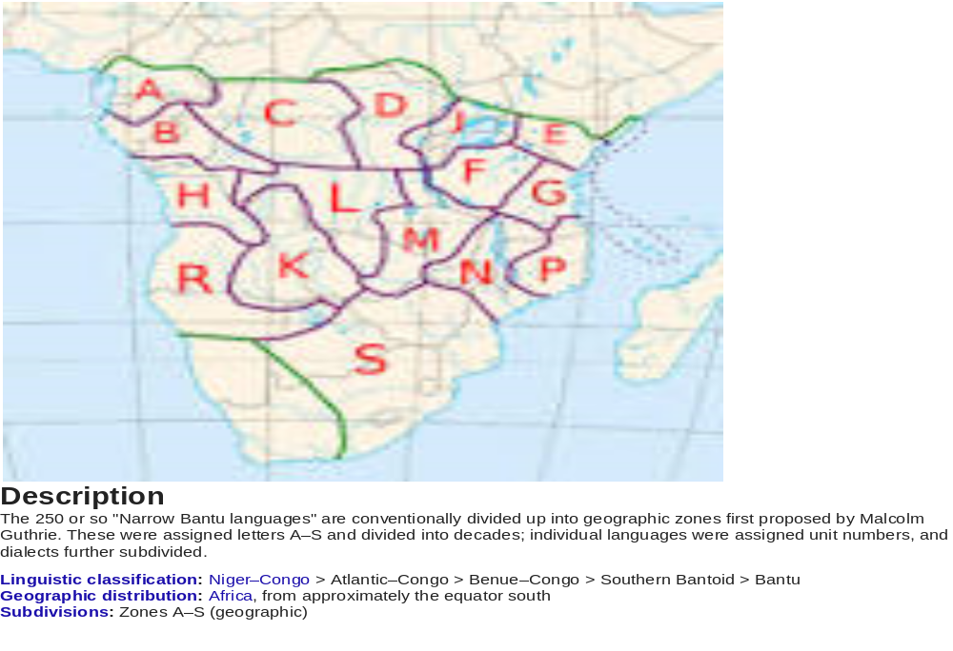

Slide 9
Exercise 2
Where is Kenya in the map of Africa?
In which region of Kenya are we in?
What is the letter denoting this zone?

Slide 10
THE VOWEL SYSTEM OF BANTU LANGUAGES
Proto Bantu is assigned 7 vowels with contrastive vowel length.
Most Bantu languages have a five vowel system or a seven vowel system. (Few have more , also a few have nasalized vowels).
The five vowel system e.g. Kiswahili (i , ε , a, ɔ, u)
Seven vowel system e.g. All the bantu languages in central Kenya/i, e, ε ,a , o, ɔ, u/
NB: Need for appropriate machines to place them precisely on the Vowel trapezium
/ ɔ

Slide 11
GῙCHUKA VOWEL SYSTEM
High Mid Low | ii: uu ee: oo: εε: ᴐᴐ: aa:

Slide 12
Short Vowels
/i/ - / keriko / ‘cooking stove’
/e/ - /andeka / ‘write’
/ε / - / tεnε / ‘in the past ‘
/ a / - / ona / ‘see’
/o/ - / roga / ‘jump’
/ ɔ / - / ɔβa / ‘tie’
7. /u/ - / ruga / ‘cook’

Slide 13
Long Vowels
/i / as in / βi:mba./ ‘ dead bodies’
/e: / as in / e:ria / ‘that one’
/ε : / as in / lε: ta / ‘bring’
/ a: / as in / b a:ria / ‘there
/ ᴐ:/ as in / ntᴐ:ɣᴐ / ‘smoke’
/o: / as in /nto:ra / ‘village’
/u: / us in /mu:ro / ‘heat wave’

Slide 14
VOCALIC PROCESSES
Vowel harmony
Gliding
Compensatory lengthening-among others

Slide 15
VOWEL HARMONY
Harmony refers to the assimilation of vowel sounds that are similar to each other in a domain e.g.
(most common being Vowel Height harmony-VHH)i.e. Vowel height on the trapezium(3 or 4 degrees)
(Backness and rounding can also be factors in vowel harmony)
Found in Verb affixes-the applicative, separative, agentive,causative(VHH)-Bantu phonology is highly sensitive to morphological considerations.

Slide 16
DEFINITION OF VOWEL HARMONY
According to Hyman (1999), vowel height harmonising is found in many Bantu languages. It is also found in Gichuka. Vowel height harmony in Gichuka is a lowering process of high vowels that are preceded by mid -vowels in the root. In the applicative suffix, the vowel ~e~ is lowered to/ ε /only before the mid-vowels {ε, ᴐ} while in the separative suffix, the vowel ~ o ~ is lowered to / ᴐ / only following an / ᴐ /

Slide 17
APPLICATIVE IN GICHUKA
(1) | Verb | Gloss | Applicative Suffix | Gloss
a) | Rĩma / rema / | ‘weed’ | rĩm-ĩra-/remera / | ‘weed for’
b) | Ringa /ringa / | ‘beat’ | ring-ĩr-a /ringera / | ‘beat for’
c) | ruga /ruga / | ‘cook’ | rug-ĩr-a / rugera / | ‘cook for’
d) | rũg a /roga / | ‘jump’ | rũg-ĩr-a / rogera / | ‘jump for’
e) | Taara / ta:ra | ‘select’ | taar-ĩr-a/ taarera / | ‘select for’
f) | Reeta /rε:ta / | ‘bring’ | rete-er-a / rεtεra / | ‘bring for’
g) | Oba / ɔβa / | ‘tie’ | oβ-er-a / ɔβεra / | ‘tie for’

Slide 18
SEPARATIVE IN GICHUKA
(2) | Verb | Gloss | Separative Suffix | Gloss
a) | Ĩkara / ekara / | ‘sit’ | ĩkar-ũk-a / ekaroka / | ‘stand’
b) | Binga / βinga / | ‘close’ | Bing-ũr-a / βingora / | ‘open’
c) | Curia / curia / | ‘hang’ | churũ-ki-a / curokia / | ‘unhang’
d) | Kũnja / konja / | ‘fold’ | kũnj-ũr-a / konjora / | ‘unfold’
e) | Maka / maka / | ‘be sad’ | Mak-ũk-a / makoka / | ‘stop being sad’
f) | Tega /tεga / | ‘put on fire’ | Teg-ũr-a / tεgora / | ‘remove from fire’
g) | Oba/ ɔβa / | ‘tie’ | Ob-or-a / ɔβɔra / | ‘untie’

Slide 19
EXPLANATION
Gichuka vowel harmony process can therefore be explained by saying that the data in (1a-e) show no harmonisation of the applicative suffix, while (1f) and (1g) do. The data in (2) shows that only the mid vowel /ᴐ / triggers harmony. Suffixes with /a / show no vowel harmony (1e and 2e). The vowel harmony is asymmetric because in the case of suffixes containing / u /, the mid vowel /ε / fails to trigger the process (2f).

Slide 20
Exercise 3
Kiswahili Vowel Harmony(Applicative)
Gloss
Fanya-fanyia do for
Pika - pikia cook for
Ruka - rukia jump for
Shona -shonea sew for
Leta - letea bring for
Study the data and summarize the vowel harmony that is found in Kiswahili
A native speaker to give us another set of data for comparison e.g. Gusii

Slide 21
Gliding
Usually the gliding of u/o and i/e into w and y respectively
For example: Kikuyu(agentive)
Gloss
Mo+aka - mwaki builder
Mo+endia - mwendia buyer
Mo+adeka - mwandeki writer
Mo+atura - mwaturi cutter

Slide 22
COMPENSATORY LENGHTHENING
The lengthening of a vowel sound upon the loss of a following consonant usually in the syllable coda.
It can also be triggered by the loss of a vowel in an adjacent syllable
Bonface to provide Gusii data:
/eᵦ-emba/ /eᵦjeemba/
emi-osi/ /emujuusi/

Slide 23
THE CONSONANT SYSTEM
General Remarks
Most Bantu languages are reported to have two sets of plosives, voiced and voiceless
Most of them have a full set of nasals at each place of articulation where a stop or an affricate appears
Most of them have a relatively limited set of fricatives
They often have one liquid but some have two e.g Gitigania
Approximants occur in Bantu languages(j,w) often alternating with high vowels(I,u)
Look out for the consonant Clusters

Slide 24
CONSONANT PHONOLOGY
Consonant Clusters
Dahl’s law

Slide 25
CONSONANT CLUSTERS
They are of two types
-a nasal + a homorganic stop e.g mp,mb,nt,nk(commonly referred to as NC clusters)
-a nasal +a glide(NG)
NB: They can vary greatly from language to language…be on the lookout for them

Slide 26
DAHL’S LAW
Voiceless stops become voiced if the consonant in the next syllable is also voiced
The process has taken place in Kikuyu as shown below:
  Gloss
-/ke + kena/ /gekeno/ happiness
-ke+tea/ /gutea/ respect
-/ke +toma/ /gitumi/ reason
Some languages have not undergone the process and there violations so the need to look at each language individually.

Slide 27
EXAMPLE: GῙCHUKA CONSONANT SYSTEM
Gichuka Consonants
 | Bilabial | Dental | Alveolar | Palatal | Velar
Plosives | b |  | t (d) | c (Ɉ) | k (g)
Trill |  |  | r
Fricative | β | ð |  |  | ɣ
Semi Vowel | (w) |  | (j)
Nasal | m |  | n | ɲ | ŋ

Slide 28
plosives
      /b/ - voiceless bilabial stop –/ ba / ‘give ’
      /t/ - voiceless alveolar stop –/ βata / ‘sweep’
      /d/ - voiced alveolar stop- / mogonda / ‘ farm/garden’
      /c/ - voiceless palatal stop – /oca / ‘pick’
      / Ɉ / - voiced palatal stop - /nɈoke / ‘ bee’
      /k/ - voiceless velar stop –/ kaβio / knife
      /g/ - voiced velar stop –/ ɣaka / ‘ this one’

Slide 29
Fricatives and Nasals
      / β / - voiced bilabial fricative - / βaβa / ‘father’
      /ð / - voiced dental fricative - / ðɔma / ‘ read’
      / ɣ / - voiceless velar fricative - / ntɔɣɔ / ‘smoke’
      / m / - bilabial nasal– / mami / ‘mother’
      / n / - alveolar nasal – / ona / see
      / ɲ / - palatal nasal – / ɲua / ‘drink’
      / ŋ / velar nasal – / ŋɔmbe / ‘cow

Slide 30
NC Clusters
Nasal Consonant | Point of Homorganic Nasal Assimilation | Phonetic Symbol | Example | Gloss
mb | Bilabial | / m͡b / | mbori | goat
nd | Alveolar | / n͡d / | ndeke | aeroplane
nj | Alveolar | / n͡j / | njoka | snake
nt | Alveolar | / n͡t / | ntaka | mud
nc | Palatal | /n͡c / | ncera | Jail
nth rw | Dental bilabial | / n͡ð / /rw/ | nthaka rwĩgĩ | circumcised young man hawk
nk | Velar | / n͡k / | nkũnia | gunny bag
ng nw | Velar bilabial | / n͡g / /nw/ | nguo nwabo | clothes Still there

Slide 31
Semi-Vowels and Trills
/ w / - bilabial semi-vowel – / waku/ ‘yours’
/ j / - palatal semi-vowel –/ mbɔja / dry maize stalk
/ r / - alveolar trill –‘ rima’ ‘ dig’

Slide 32
OTHER PROCESSES
NB: There are other processes such as Bantu spirantization, aspiration, palatalization, nasal harmony, nasalization and others that we need to be on the look out for. I have only looked at those which are commonly attested.

Slide 33
SYLLABIFICATION IN BANTU
Bantu syllable structure is open
Summary(N)CV,NV,V)
Unresolved issues on Bantu syllabification include :
-syllabic status of consonant clusters
-resolution of vowel hiatus

Slide 34
Exercise 4
Generate words from Bantu words in pairs/groups and identify the syllables e.g
muntu, mwari, ino,etc

Slide 35
BANTU ORTHOGRAHY
Orthography- the way a language is written
It is a wide topic because of the no. of languages
A look at Gichuka orthography will help us transcribe Central Kenya Bantu languages
For an in depth study refer to the Bantu Orthography Manual (2010) by Leila Schroeder published by SIL international.

Slide 36
GICHUKA CONSONANTS
Phonetic
symbol Orthography Example Gloss
/ ɲ / - ny nyũmba house
/ β / – b- βaβa father
/ ɣ /- g - gũkũ here
/ Ɉ /- j- njũkĩ bee
/ ŋ / – ng-’ ng’ombe cow

Slide 37
VOWEL ORTHOGRAPHY
Phonetic
Symbol Orthography Example Gloss
/i / i indo ‘ things’ /e / ĩ kĩriko ‘charcoal stove’
/ε / e tene ‘ in the past ‘
/ a / a gaka ‘this one’
/o / ũ rũga ‘ jump’
/ ɔ / o ona see’
/u / u ruga ‘cook’

Slide 38
CLOSING REMARKS
The nature of Bantu languages is such that phonological processes are influenced by morphological processes especially noun classes…as we look at morphology later. It will become clearer.
Area not looked at-phonotactics of Bantu Languages
THANK YOU.

