Slide 1
Setting up a linguistic fieldwork project

Slide 2
What is fieldwork?
Hyman (2001): “a state of mind” -> prototype
 | Fieldwork prototype | Fieldwork countertype | Least field-work-like
Elicitee | Other | Self | Introspection
Elicitor/Observer | Self | Other | Secondary data
Distance | Far | Near | One’s domicile
Setting | Small | Large | City, university
Duration | Long | Short | Brief stopover
Language | Exotic | Well-known | One’s own
Subject Matter | Languages as used in their natural/cultural context | Language in general as a formal system | Abstract syntax
Data | Naturalistic | Controlled | Synthetic speech
Motivation | Languages-driven | Theory-driven | Mathematical linguistics

Slide 3
Why do fieldwork?
Language endangerment
Underdocumentation
Linguistic Theory

Slide 4
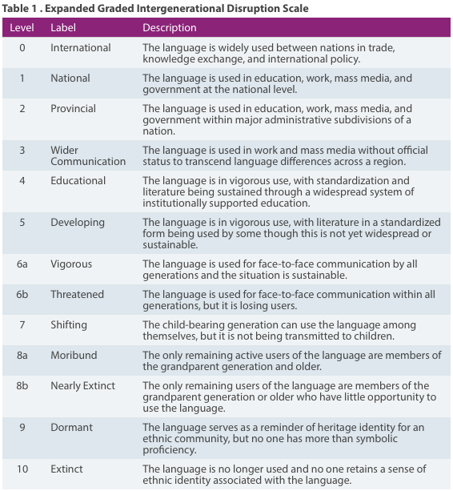
EGIDS
(Ethnologue)

Slide 5
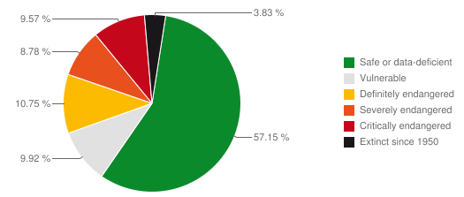
UNESCO Atlas of World’s Languages in Danger
http://www.unesco.org/languages-atlas/index.php
Notes:
underestimate, sign lgs, non-standard varieties etc
number of speakers, but also intergenerational transfer

Slide 6
So what?
Language endangerment occurs often in situations of inequality
Language is part of, and a carrier of, local cultures, so preserving/activating a language can keep cultural traditions alive
As linguists we want to study as many languages as possible (for reconstruction, UG, etc.)

Slide 7
So what does fieldwork have to do with it?
Documentation can help renew the interest and motivation of native speakers
Description provides a basis for language materials
Materials can help revitalise a language
Documentation provides access to the language data even if the language does eventually die.

Slide 8
Under-documentation
Basically, a word list or a 100-page reference grammar are not enough to answer more complicated and detailed linguistic questions
So we need to get out there and gather more data!

Slide 9
Linguistic theory
Description and theory depend on each other
  There is no such thing as a theory neutral description!
  Any analysis of a language involves abstraction from the data, and the way in which we abstract is conditioned by our theoretical assumptions.
Theory informs description: it forces one to make explicit hypotheses and therefore arrive at new questions
Data inform theory: if the hypothesis is proven false by the data, or if data on a new phenomenon appear, the theory needs to be adjusted

Slide 10
So how do we do it?
We need someone who speaks the language (as a native speaker with active command of the language)
And then what?
Elicited vs. semi-spontaneous vs. spontaneous data
Recorded and transcribed
(More on this on Friday!)
We need a research question and project!

Slide 11
8 steps to an effective linguistic research project
Choose a (broad) topic
Brainstorm (alone or with others). It is important at this stage to just generate ideas, even bad ones. Just jot them down – selecting will come later.
  Why is this interesting?
  Which different questions can we ask?
  Ask ‘what if…’ questions regarding your topic
  Try to think from different angles
Check what the current thinking is about this topic, and what has already been done
Select and formulate one specific research question (and thereby also limit your research area and objectives in a realistic way!)
Formulate subquestions whose answers are needed to answer the overall research question
Determine which data are needed to deduce an answer to the subquestions (if this is unrealistic, return to 4 and 5)
Match an appropriate methodology (longer stretch of speech, specific recordings, judgements)
Make a plan for when to do what, taking into account that speakers are human beings ☺

Slide 12
Learning from experience
Take 5 minutes to reflect on previous projects
(in study or personal life):
What worked well?
What are your personal potential pitfalls?
What do you want to improve?

Slide 13
Example research questions
Tone in Kimeru
Description of lexical tone in Kimeru
Description of lexical tone in the Kimeru noun phrase: the influence of modifiers

Slide 14
Get started!
Tell your neighbour your topic of interest, as broadly or as narrowly as you are currently thinking about it
Determine which step in the process you are at, or which is most useful for you at this moment (we will have further time to set up your precise project in the rest of this week)
Put in some time and effort at that step, and perhaps the next

Slide 16
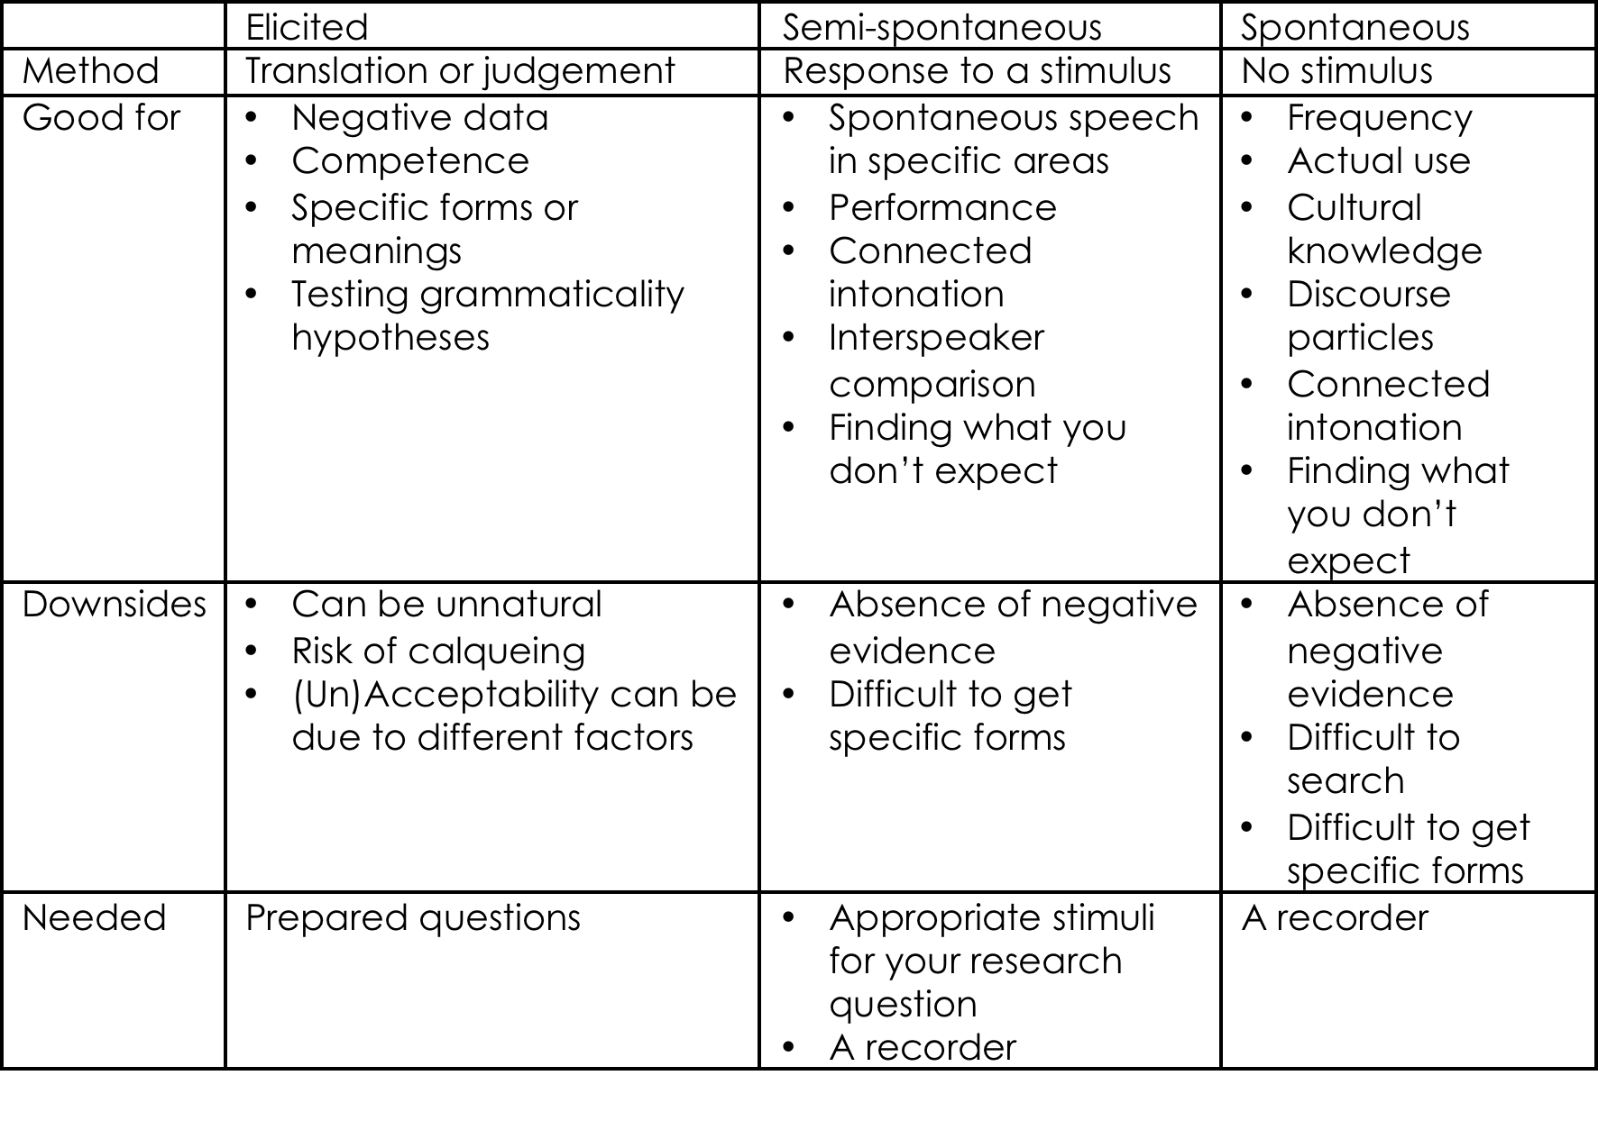

Slide 17
Elicitation pitfalls
Speaker may accept a sentence because
  they’re being polite
  they do not care or are tired
  you’re a foreigner
  they misinterpreted the question/stimulus
  it’s a good sentence!
Speaker may reject a sentence because
  they’re making life difficult for you
  they do not care or are tired
  this is not the prescribed/taught form
  there is a mistake in a part of the sentence you weren’t after
  the wrong context is imagined
  the sentence has a semantic or cultural implausibility
  it’s an ungrammatical or infelicitous sentence!

Slide 18
Working with an informant
They are a collaborator on the project.
They are your teacher. They have the i-language you’re after, so assume that they are right.
Be respectful, polite, and patient.
Show interest and be appreciative, even when things are not moving in the direction you had in mind. You might find something even more interesting!
Be mindful of their state (bored, tired, …) and the tasks you ask them to do.
Manage your own reactions to their responses to not put them off or bias them.
By participating in this class, you agree to treat the obtained data with care!

Slide 19
Ethics
Agree beforehand with the community and speakers who owns the data – sign a consent form
Agree with the speaker whether and how much to pay. This depends partly on your budget, but mostly on the local culture. (for the LIKE, this has been organized)

