Slide 1
What we found is (not just) a focus construction
Jenneke van der Wal – Leiden University
Patrick Njue Kanampiu - Tharaka University College

Slide 2
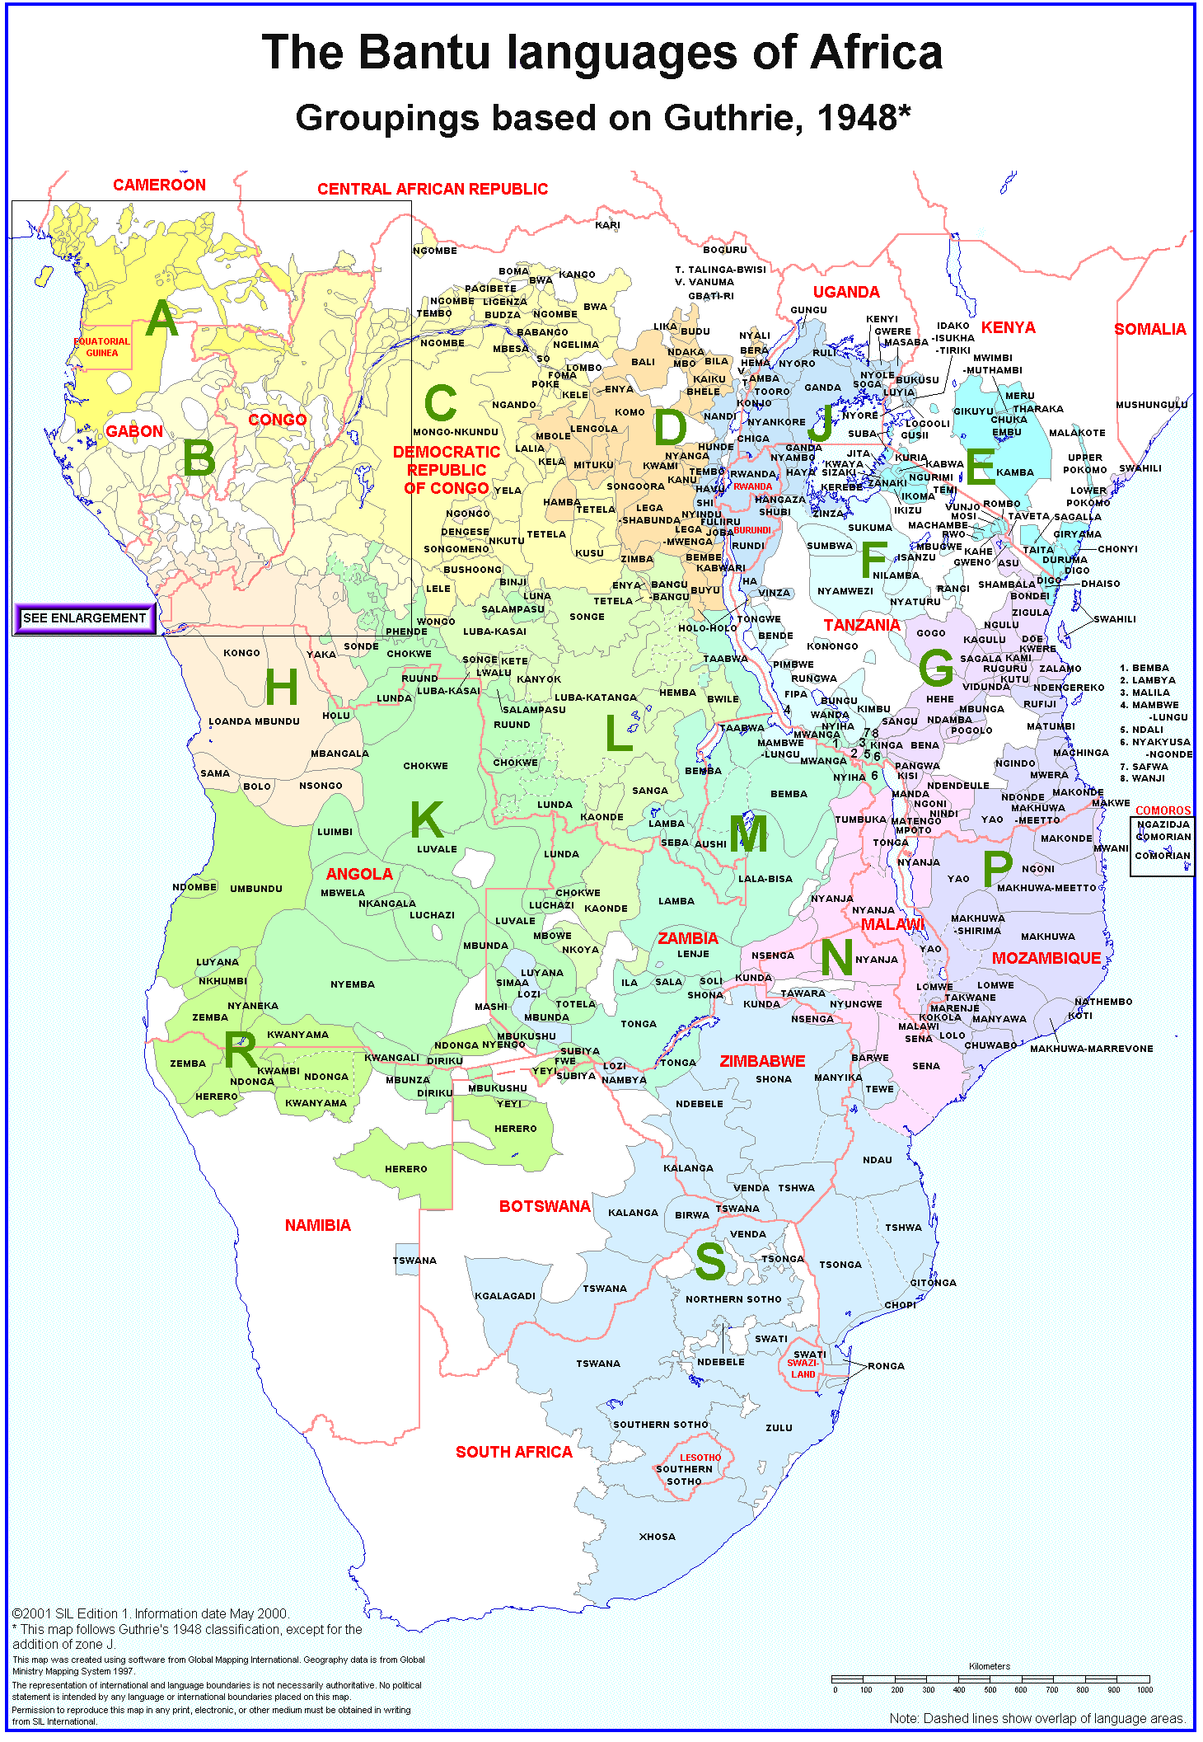
BaSIS
Bantu Syntax and Information Structure
How do Bantu languages express information structure, and (how) is this related to case licensing?
Collaborators & PhD students

Slide 3
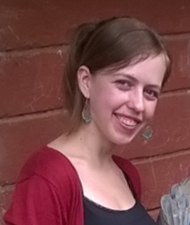


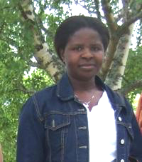

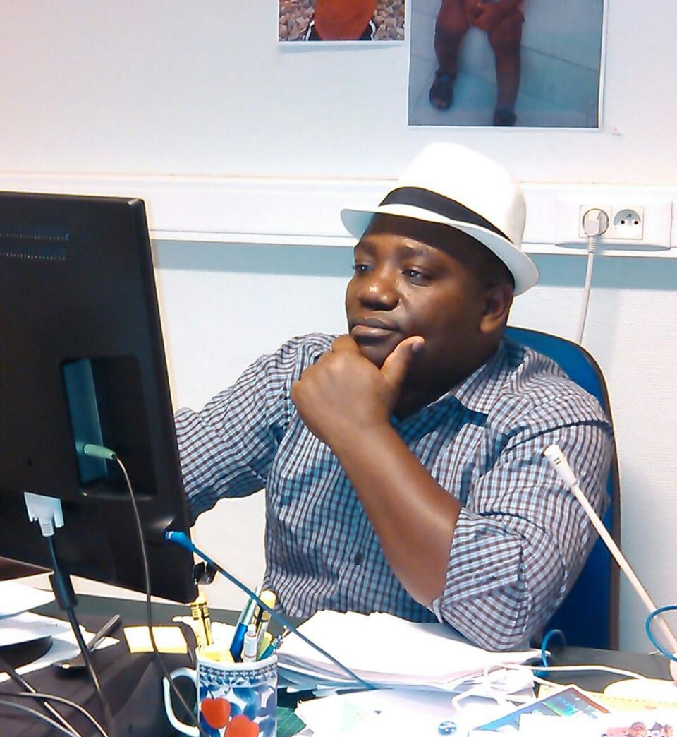

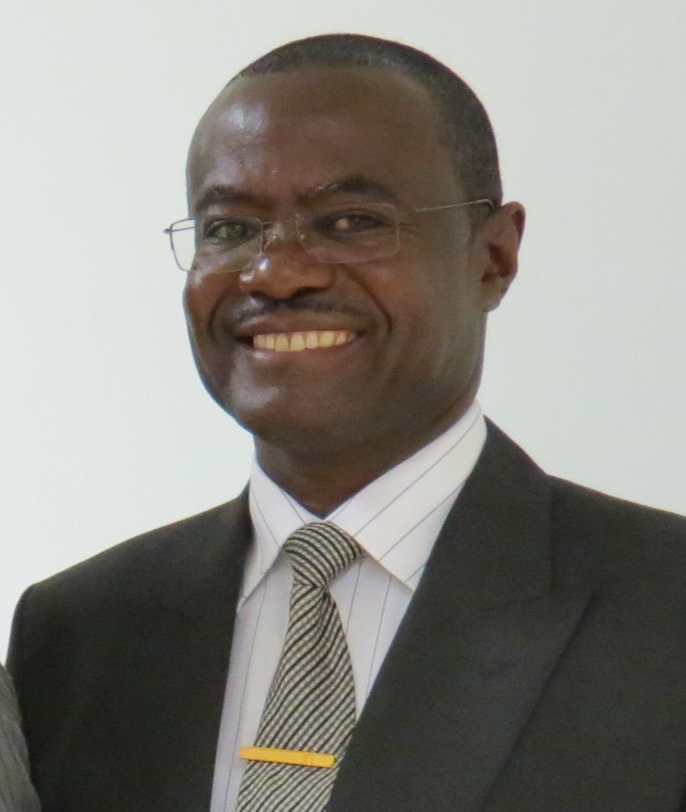
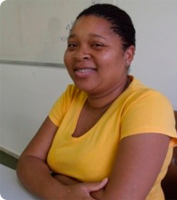
Team
Elisabeth Kerr
Leiden University
Tunen
Patrick Kanampiu
Tharaka University College
Kîîtharaka
Zhen Li
Leiden University
Teke
Amani Lusekelo
University of Dar es Salaam
Nyakyusa
Allen Asiimwe
Makerere University
Rukiga
Jenneke van der Wal
Leiden University
Makhuwa
Ernest Nshemezimana
University of Burundi
Kirundi
Aurelio Simango
Universidade Eduardo Mondlane
Changana
Jekura Kavari
University of Namibia
Otjiherero
Nelsa Nhantumbo
Universidade Eduardo Mondlane
Copi

Slide 5
(1) Kî-ronda gîkî gi-ake gî-k-oor-u-a…
7-wound 7.dem.prox 7-poss 7sm-fut-heal-pass-fv
‘This wound of hers will be healed…’
Notes:
KT = 27, order, noun class

Slide 6
Pseudocleft
(2) (What exactly did Karîmi kick?)
[Kî-rá Karîmi á-rííng-iré] í mû-bíírá.
7-dem.dist Karimi 1sm-kick-pfv cop 3-ball
'What Karîmi kicked is a ball.’
FR ni NP
Notes:
i/n
(“nothing else”)

Slide 7
N’we construction
(3) (What exactly did Karîmi kick?)
Mû-biira n’-uu Karîmi a-riing-iré.
3-ball cop-pro 1.Karimi 1sm-kick-pfv
'A ball is what Karimi kicked.'
NP ni-pro V
Notes:
i/n

Slide 8
The mine field
NP ni NP
Jane ni teacher
copular clause
FR ni NP
who teaches ni Jane
pseudocleft
NP ni FR
Jane ni who teaches
reverse pseudocleft
FR ni-pro NP
who teaches ni Jane
reverse n’we construction
NP ni-pro REL
Jane ni who teaches
n’we construction
predicational/specificational = x2
focus initial/final = x2

Slide 9
Reverse pseudocleft
[Ûra û-kû-thaambia thaani] i Rob.
1.dem.dist 1rm-prs-wash 10.dishes cop 1.Rob
‘The one who is washing the dishes is Rob.’
Rob n’ [ûra û-kû-thaambia thaani].
1.Rob cop 1.dem.dist 1rm-prs-wash 10.dishes
‘Rob is the one who is washing the dishes.’
Rob n’-we [û-kû-thaambi-a thaáni]
1.Rob cop-1.pro 1rm-prs-wash-fv 10.dishes
‘Rob is the one who is washing the dishes’
FR ni NP
NP ni FR
NP ni-pro REL

Slide 10
Mapping the mine field
How is focus encoded in Kîîtharaka morphosyntax? > big question!
What is the syntactic structure of these constructions? > today
How does the interpretation follow? > work in progress…
Copular clauses, pseudoclefts, and reverse pseudoclefts
N’we construction
Inverse n’we construction

Slide 11
Copular clauses and (reverse) pseudoclefts

Slide 12
The mine field
NP ni NP
Jane ni teacher
copular clause
FR ni NP
who teaches ni Jane
pseudocleft
NP ni FR
Jane ni who teaches
reverse pseudocleft
FR ni-pro NP
who teaches ni Jane
reverse n’we construction
NP ni-pro REL
Jane ni who teaches
n’we construction
predicational/specificational
focus initial/final

Slide 13
(4) (What does Jane do for a living?)
Jane i mwarimû.
1.Jane cop 1-teacher
‘Jane is a teacher.’ [predicational]
(5) (Who is the chef?)
Chebu i mw-ekûrû ûyû.
chef cop 1-woman 1.dem.prox
‘The chef is this woman.’ [specificational]

Slide 14
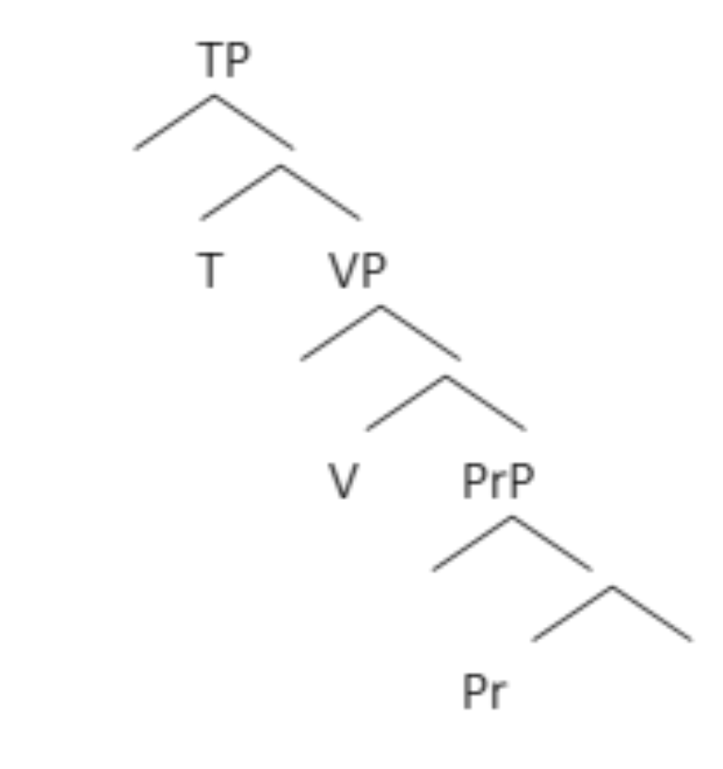
predicational
specificational
subject
subject
predicate
predicate
Theresa is a linguist/smart/in Cambridge.
The linguist is Theresa.
Notes:
Bowers 1993, also Adger & Ramchand 2003 and Baker 2003 PredP

Slide 15
(6) (In an animal folktale.)
a. Mû-tûûri w-eétû a-a-rî m-bûri.
1-neighbour 1-poss.1pl 1sm-pst-be 9-goat
‘Our neighbour was a goat.’
b. M-bûri îî-ra y-aa-rî mû-tûri w-eétû.
9-goat 9-dem.dist 9sm-pst-be 1-neighbour 1-poss.1pl
‘That goat was our neighbour.’
Notes:
agreement

Slide 16
The mine field
NP ni NP
Jane ni teacher
copular clause
PrP + inversion
FR ni NP
who teaches ni Jane
pseudocleft
NP ni FR
Jane ni who teaches
reverse pseudocleft
FR ni-pro NP
who teaches ni Jane
reverse n’we construction
NP ni-pro REL
Jane ni who teaches
n’we construction
predicational/specificational
focus initial/final

Slide 17
The mine field
NP ni NP
Jane ni teacher
copular clause
PrP + inversion
FR ni NP
who teaches ni Jane
pseudocleft
NP ni FR
Jane ni who teaches
reverse pseudocleft
FR ni-pro NP
who teaches ni Jane
reverse n’we construction
NP ni-pro REL
Jane ni who teaches
n’we construction
predicational/specificational
focus initial/final

Slide 18
(7) (I’ve been referred to room B10 to find Aron. There are five people in the room. Who is Aron?)
Aron n’ ûyû.
1.Aron cop 1.dem.prox
‘Aron is this (one).’
#Ûyû n’Aron.
(8) (The university theatre club puts on a performance of the nativity every year.)
Josef n’ Onesmus mw-anka ûyû.
1.Joseph cop 1.Onesmus 3-year 3.dem.prox
‘Onesmus is Joseph this year.’

Slide 19
The mine field
NP ni NP
Jane ni teacher
copular clause
PrP + inversion
FR ni NP
who teaches ni Jane
pseudocleft
NP ni FR
Jane ni who teaches
reverse pseudocleft
FR ni-pro NP
who teaches ni Jane
reverse n’we construction
NP ni-pro REL
Jane ni who teaches
n’we construction
predicational/specificational
focus initial/final

Slide 20
The mine field
NP ni NP
Jane ni teacher
copular clause
PrP + inversion
FR ni NP
who teaches ni Jane
pseudocleft
NP ni FR
Jane ni who teaches
reverse pseudocleft
FR ni-pro NP
who teaches ni Jane
reverse n’we construction
NP ni-pro REL
Jane ni who teaches
n’we construction
predicational/specificational
focus initial/final

Slide 21
(9) [Kî-rá Karîmi á-rííng-iré] í mû-bíírá.
7-dem.dist Karimi 1sm-kick-pfv cop 3-ball
'What Karîmi kicked is a ball’ (“nothing else”)
(10) [Ba-rá ba-p-éer-w-é tû-rámu] i tw-áána tu-unka.
2-dem.dist 2-give-pfv-pass-fv 13-pens cop 13-children 13-only
‘Those that were given pens are the children only.'

Slide 22
(11) N-thígiirí [í-rá n-da-nénké-ére û́-kî]
10-black.ants 10-dem.dist 1sg.sm-ypst-give-pfv 14-honey
i ci-aakén-íre mûnó.
cop 10sm-become.happy-pfv int
'The black ants that I gave honey are very happy.’
(12) Gî-túmá [kî-rá mb-îgw-iiré], í-gî-kû-rî kî-néné mûnó.
7-noise 7-dem.dist 1sg.sm-hear-pfv foc-7sm-prs-be 7-big int
'The noise that I heard was very loud.'
Notes:
can also be kîku medial demonstrative (but cannot be absent)

Slide 23
(13) (Mû-ntu) [Û-ra gw-ît-iré] a-káa-y-a.
1-person 1-dem.dist 2sg.sm-call-pfv 1sm-fut-come-fv
'The one you called will come’
(14) I-mb-endeete (kî-ntu) [kî-ra mb-on-ire].
foc-1sg.sm-like 7-thing 7-dem.dist 1sg.sm-see-pfv
‘I like the thing that/what I saw.’
Notes:
free relative as subject and object

Slide 24
Predicational (AP)
(15) [Kîra kî-m-bay-ith-iir-í-e] i kî-thûûku mûno.
7-dem.dist 7sm-1sg.om-become.ill-caus-pfv-ic-pfv cop 7-bad int
'What made me ill is very dangerous.’
Predicational/specificational?
(16) [Ûra ndoona] i mwarimû.
û-ra n-ra-on-a ni mû-arimû
1-dem.dist 1sg.sm-npst-see-fv cop 1.teacher
‘Who/the one I have seen is a/the teacher.’

Slide 25
“What you have left is dog food”
specificational
predicational
Notes:
Higgins 1979

Slide 26
FR NP
(17) [Kî-ra w-a-tigaria] n’ [irio bi-a kûrû].
7-dem.dist 2sg.sm-pst-leave cop 8.food 8-conn 15.dog
‘What you left is food for the dog.’
predicational
specificational
FR
NP
NP
FR
You cannot eat all the food on your plate, so whatever you cannot eat will be given to the dog.
You forgot to bring something when shopping, namely dog food.

Slide 27
The mine field
NP ni NP
Jane ni teacher
copular clause
PrP + inversion
FR ni NP
who teaches ni Jane
pseudocleft
PrP + inversion
NP ni FR
Jane ni who teaches
reverse pseudocleft
FR ni-pro NP
who teaches ni Jane
reverse n’we construction
NP ni-pro REL
Jane ni who teaches
n’we construction
predicational/specificational
focus initial/final

Slide 28
The mine field
NP ni NP
Jane ni teacher
copular clause
PrP + inversion
FR ni NP
who teaches ni Jane
pseudocleft
PrP + inversion
NP ni FR
Jane ni who teaches
reverse pseudocleft
FR ni-pro NP
who teaches ni Jane
reverse n’we construction
NP ni-pro REL
Jane ni who teaches
n’we construction
predicational/specificational
focus initial/final

Slide 29
NP FR
(18) [Irio bi-a kurû] i [bi-rá w-a-tigaría].
8.food 8-conn 15.dog cop 8-dem.dist 2sg.sm-pst-leave
‘The food for the dog is what you left.’
predicational
specificational
FR
NP
NP
FR
There are some leftovers on your plate, and there is some food in the pot. What shall we feed the dog with tonight?
You have bought chicken’s and dog’s food, but left one. Which is the dog’s food?

Slide 30
The mine field
NP ni NP
Jane ni teacher
copular clause
PrP + inversion
FR ni NP
who teaches ni Jane
pseudocleft
PrP + inversion
NP ni FR
Jane ni who teaches
reverse pseudocleft
FR ni-pro NP
who teaches ni Jane
reverse n’we construction
NP ni-pro REL
Jane ni who teaches
n’we construction
predicational/specificational
focus initial/final

Slide 31
(19) (I am looking for Rob, who is working in a kitchen full of people. I ask ‘Who is Rob?’)
Rob n’ [ûra û-kû-thaambia thaani]
1.Rob cop 1.dem.dist 1rm-prs-wash 10.dishes
‘Rob is the one who is washing the dishes.’
(20) (Someone thinks erroneously that Joy is doing the dishes.)
[Ûra û-kû-thaambia thaani] i Rob.
1.dem.dist 1rm-prs-wash 10.dishes cop 1.Rob
‘The one who is washing the dishes is Rob.’

Slide 32
The mine field
NP ni NP
Jane ni teacher
copular clause
PrP + inversion
FR ni NP
who teaches ni Jane
pseudocleft
PrP + inversion
NP ni FR
Jane ni who teaches
reverse pseudocleft
FR ni-pro NP
who teaches ni Jane
reverse n’we construction
NP ni-pro REL
Jane ni who teaches
n’we construction
predicational/specificational
focus initial/final

Slide 33
(reverse) Pseudoclefts
FR behaves exactly like a noun
FR and NP can be subject or predicate
Either one can move to specTP, resulting in predicational and specificational readings
  NP = NP
  FR = NP
  NP = FR
Focus is always on the postcopular phrase – postverbal default interpretation
Accounted for in PrP analysis plus inversion

Slide 34
N’we construction

Slide 35
The mine field
NP ni NP
Jane ni teacher
copular clause
PrP + inversion
FR ni NP
who teaches ni Jane
pseudocleft
PrP + inversion
NP ni FR
Jane ni who teaches
reverse pseudocleft
FR ni-pro NP
who teaches ni Jane
reverse n’we construction
NP ni-pro REL
Jane ni who teaches
n’we construction
predicational/specificational
focus initial/final

Slide 36
(21) (There is a dispute over what Kawîîra saw.)
Múúró n’úú Kawî́î́ra óóníre.
muu-ro ni-u-o Kawîîra a-on-ire
3-river cop-3-pro 1.Kawîîra 1sm-see-pfv
'A river is what Kawîîra saw.’
(22) (Which books by Ngũgĩ wa Thiong’o would you recommend?)
The River Between i-rî-o rî-ega.
The River Between cop-5-pro 5-good
'The River Between is the best book.’ (îbuku ‘book’ is in class 5)
(23) (You might think that it was Peter who talked, but…)
nDáníérí n’-wé á-ár-iir-i-é.
1.Daniel cop-1.pro 1sm-talk-pfv-ic-fv
'Daniel (is the one who) talked.’
NP ni pro REL

Slide 37
(24) Tóm n’-á-rá-ín-íre na=wé.
1.Tom foc-1sm-ypst-sing-pfv with=1.pro
'Tom sang with him/her.’
(25) (Does the man have four melons?)
Arî́, i ma-thátû a-rî na=mó.
no cop 6-three 1sm-be with=6pro
‘No, he has three’, lit. ‘it is three that he is with them’
(referring to melons, class 6)
(26) Pátrî́k n’-wé (*û-ra) a-ga-tóóngór-í-á.
1.Patrick cop-1.pro 1-dem.dist 1rm-fut-lead-ic-fv
'Patrick is (the one) who will chair us.'
Notes:
pronoun, no relative-marking demonstrative!

Slide 38
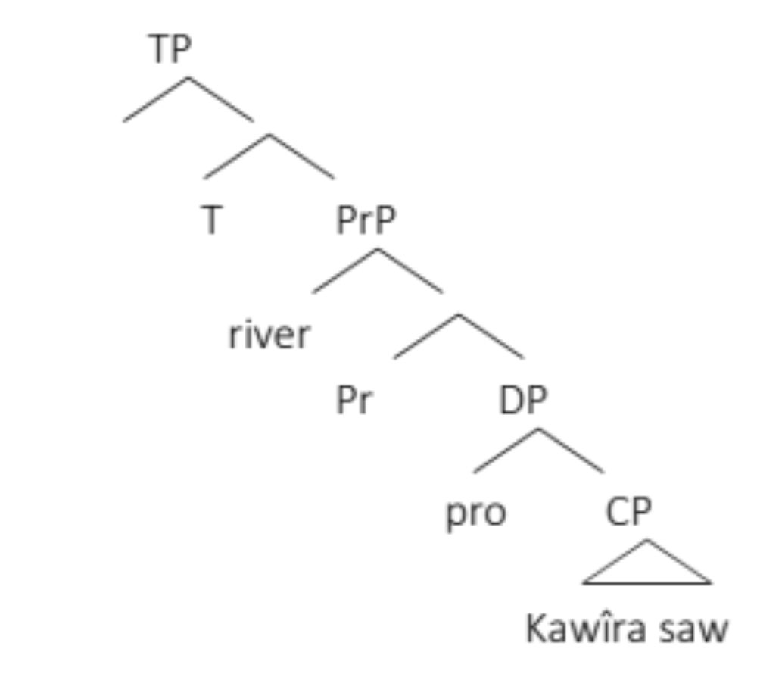
Is it a copular clause?
Múú-ró n’-úú Kawî́î́ra óón-íre.
3-river cop-3-pro 1.Kawîîra 1sm.see-pfv
‘The river is it, which/that Kawîra saw’
‘The river is what Kawîra saw’

Slide 39
1: Optional relative marking
(27) a. Pátrî́k n’-wé á-ga-tóóngór-í-á.
1.Patrick cop-1.pro 1sm-fut-lead-ic-fv
'Patrick is the one to chair us.’
b. Pátrî́k n’wé û-ga-tóóngór-í-á.
1.Patrick cop-1.pro 1rm-fut-lead-ic-fv
'Patrick is the one to chair us.'
Notes:
anti-agreement

Slide 40
2: Relative clause cannot be omitted
(28)
*The River Between i-rîo.
‘The River Between is it.’
The River Between i-rîo rî-ega.
The River Between cop-5-pro 5-good
'The River Between is the best book.’

Slide 41
3: Pro-relative cannot be inverted
(29) a. [kî-ra û-kw-ona] i [ky-o û-ga-p-ew-a]
7-dem.dist 2sg.sm-prs-see cop 7-pro 2sg.sm-fut-give-pass-fv
‘What you see is what you get.’
b. *[kyo ûkwona] i [kyo ûgapewa]
7-pro 2sg.sm-prs-see cop 7-pro 2sg.sm-fut-give-pass-fv
c. *[kyo ûkwona] i [kîra ûgapewa]
7-pro 2sg.sm-prs-see cop 7-dem.dist 2sg.sm-fut-give-pass-fv
(30) [Ûra / *We û-kû-thaambia thaani] i Rob.
1-dem.dist / 1.pro 1rm-prs-wash 10.dishes cop 1.Rob
‘The one/he who washes dishes is Rob

Slide 42
4: Past tense does not replace ni
(31) Téné mû́nó m̀-biti na ka-yû́gû́ ba-a-rî́ a-cooré.
long very 9-hyena and 12-hare 2sm-pst-be 2-friends
‘A long time ago, hyena and hare were friends.’
(32) a. Ny-oombá ni-y-ó î-rá-bî́-íre (y-óónka).
9-house cop-9-pro 9sm-ypst-burn-pfv 9-only
‘(Only) the house is what has burnt.’
  b. *Ny-oombá y-aa-rî-yó î-rá-bî́-íre (yóónka).
  9-house cop-9-pro 9sm-ypst-burn-pfv 9-only
  int. ‘(Only) the house was what has burnt.’
(In a play, when someone asked ‘Was the goat your grandmother?’)
(33) Mû-tûûri w-eetû n'-we w-aa-rî m-bûri.
1-neighbour 1-poss.1pl cop-1.pro 1rm-pst-be 9-goat
‘Our neighbour was the goat.’
Notes:
differs from Kinande in which pst tense + be precedes ni (ni = pred)

Slide 43
5: Focus is on the referent of the initial NP and the pro
(34) (Where is a good place to go on a holiday?)
Mombasa i kw-éégá gw-á kû-riûnga
9.Mombasa cop 17-good 17-conn 15-visit/tour
'Mombasa is a good place to visit/tour’
(35) (Interpretation: there are no other places that are good)
Nanyukî i-kû kw-éégá
9.Nanyuki cop-17.pro 17-good
'Nanyuki is the place that is good’
(36) (Is Joy doing the dishes?)
Rob n’-we [û-kû-thaambi-a thaáni]
1.Rob cop-1.pro 1rm-prs-wash-fv 10.dishes
‘Rob (is the one who) is washing the dishes’

Slide 44
The mine field
NP ni NP
Jane ni teacher
copular clause
PrP + inversion
FR ni NP
who teaches ni Jane
pseudocleft
PrP + inversion
NP ni FR
Jane ni who teaches
reverse pseudocleft
FR ni-pro NP
who teaches ni Jane
reverse n’we construction
PrP ☹
NP ni-pro REL
Jane ni who teaches
n’we construction
predicational/specificational
focus initial/final

Slide 45
The mine field
NP ni NP
Jane ni teacher
copular clause
PrP + inversion
FR ni NP
who teaches ni Jane
pseudocleft
PrP + inversion
NP ni FR
Jane ni who teaches
reverse pseudocleft
FR ni-pro NP
who teaches ni Jane
reverse n’we construction
PrP ☹
NP ni-pro REL
Jane ni who teaches
n’we construction
predicational/specificational
focus initial/final

Slide 46
Is it a cleft?
Múú-ró n’-úú Kawî́î́ra óón-íre.
3-river cop-3-pro 1.Kawîîra 1sm.see-pfv
‘The river, it is THAT that Kawîra saw.’
(37) Í mû-gaáté Áshá a-gû-kaand-a.
cop 3-bread 1.Asha 1sm-prs-bake-fv
'It's bread that Asha is baking.'

Slide 47
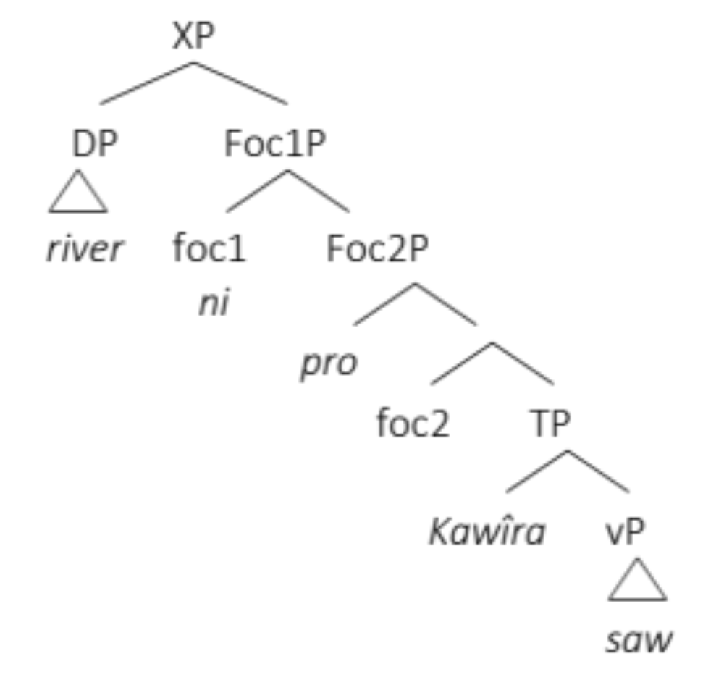
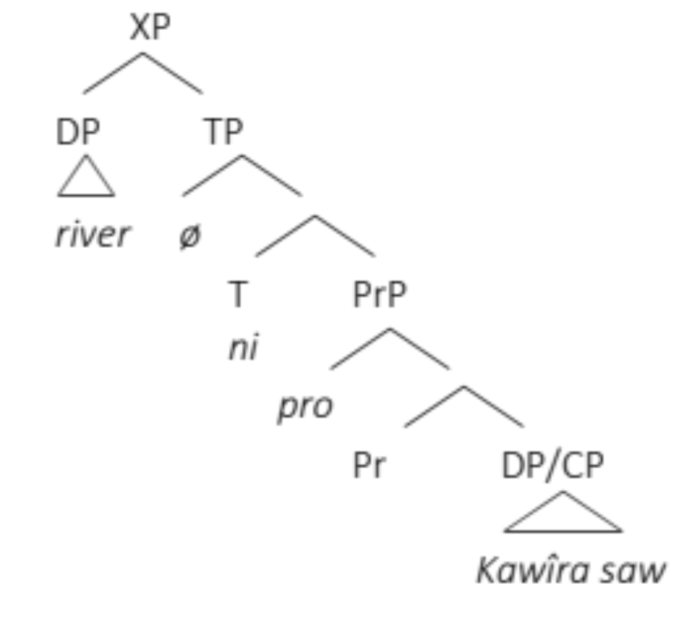

Slide 48
1: Optional relative marking
(27) a. Pátrî́k n’-wé á-ga-tóóngór-í-á.
1.Patrick cop-1.pro 1sm-fut-lead-ic-fv
'Patrick is the one to chair us.’
b. Pátrî́k n’wé û-ga-tóóngór-í-á.
1.Patrick cop-1.pro 1rm-fut-lead-ic-fv
'Patrick is the one to chair us.'

Slide 49
6: Prosody of left-dislocation
(38) (How did the doctor sign this, given that he doesn’t have a pen?)
(Whose pen did the doctor borrow?)
Ka-rámú gá-akwá, i-k-ó n-dagitárí a-ra-roomb-íre.
12-pen 12-1sg.poss cop-12-pro 9-doctor 1sm-ypst-borrow-pfv
'My pen is what the doctor borrowed.' / ‘My pen, it is that that the doctor borrowed.’
(39) (There is an egg, where did it come from? Pointing at chicken.)
N-gûkû î-nú, n-îy-ó î-ra-siár-ire.
9-chicken 9-dem.med foc-9-pro 9sm-ypst-give.birth-pfv
'That chicken is which gave birth.' / ‘That chicken, it’s her who gave birth.’

Slide 50
7: Optionality (left-dislocated) NP
(40) I-ky-o gî-tem-ag-a n-gûkû î-kurur-a.
cop-7-pro 7sm-make-hab-fv 9-chicken 9sm-crow-fv
‘That’s why Chicken crows.’
‘It is that that makes Chicken crow.’

Slide 51
The mine field
NP ni NP
Jane ni teacher
copular clause
PrP + inversion
FR ni NP
who teaches ni Jane
pseudocleft
PrP + inversion
NP ni FR
Jane ni who teaches
reverse pseudocleft
FR ni-pro NP
who teaches ni Jane
reverse n’we construction
cleft + LD
NP ni-pro REL
Jane ni who teaches
n’we construction
predicational/specificational
focus initial/final

Slide 52
The mine field
NP ni NP
Jane ni teacher
copular clause
PrP + inversion
FR ni NP
who teaches ni Jane
pseudocleft
PrP + inversion
NP ni FR
Jane ni who teaches
reverse pseudocleft
FR ni-pro NP
who teaches ni Jane
reverse n’we construction
cleft + LD
NP ni-pro REL
Jane ni who teaches
n’we construction
predicational/specificational
focus initial/final

Slide 53
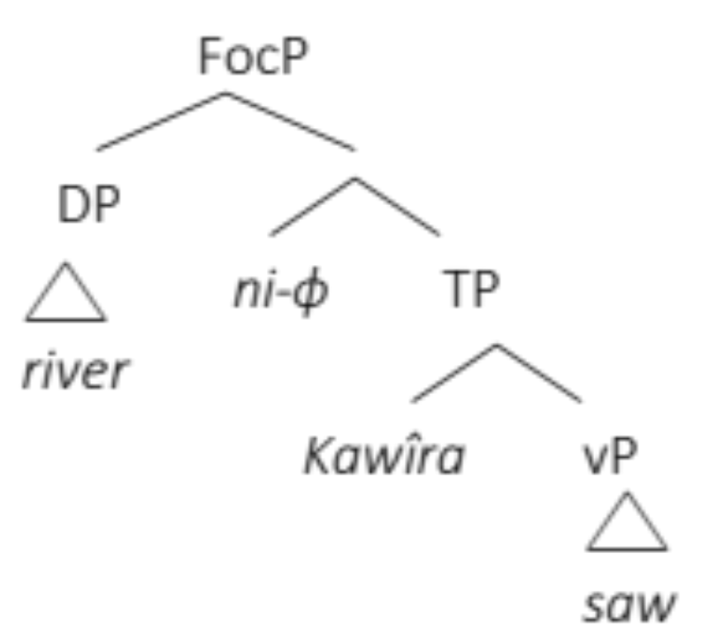
Is it a focus projection?
Notes:
relative marking and optionality DP unexpected

Slide 54
The mine field
NP ni NP
Jane ni teacher
copular clause
PrP + inversion
FR ni NP
who teaches ni Jane
pseudocleft
PrP + inversion
NP ni FR
Jane ni who teaches
reverse pseudocleft
FR ni-pro NP
who teaches ni Jane
reverse n’we construction
cleft + LD
NP ni-pro REL
Jane ni who teaches
n’we construction
predicational/specificational
focus initial/final

Slide 55
(41) Kî-ra w-a-tigaria i-ky-o irio bi-a kûrû.
7-dem.dist 2sg.sm-pst-leave foc-7-pro 8.food 8-conn 15.dog
‘What you left is food for the dog.’
Predicational:
The dog won’t be given any other food but what you have left over.
Specificational:
Your friend pranked you and put normal food and dog food on your plate, and they look almost the same. You eat, but leave part of the food on your plate. Afterwards, your friend tells you there was dog food on your plate, and you say: ‘Oh my! Did I just eat the dog food?!’ No, …
Notes:
note that for the n’we construction kîra and the pronoun could not both be present, and here that’s okay – a reason to suspect they’re different

Slide 56
The mine field
NP ni NP
Jane ni teacher
copular clause
PrP + inversion
FR ni NP
who teaches ni Jane
pseudocleft
PrP + inversion
NP ni FR
Jane ni who teaches
reverse pseudocleft
FR ni-pro NP
who teaches ni Jane
reverse n’we construction
cleft + LD
NP ni-pro REL
Jane ni who teaches
n’we construction
predicational/specificational
focus initial/final

Slide 57
(42) (Is Mûtugi the one with the funny nose?)
Û-ra á-rî́ na m-eetho má-tuúne n’-we Mûtúgí.
1-dem.dist 1sm-be with 6-eye 6-red cop-1.pro 1.Mûtugi
‘Who has brown eyes is the one / Mûtugi.’
(43) (Are you Rob?)/(Is Rob the one baking bread?)
[Û-ra û-kû-thaambi-a thaáni] n’-we Rob.
1-dem.dist 1rm-prs-wash-fv 10.dishes cop-1.pro 1.Rob
‘The one washing dishes is Rob.’

Slide 58
The mine field
NP ni NP
Jane ni teacher
copular clause
PrP + inversion
FR ni NP
who teaches ni Jane
pseudocleft
PrP + inversion
NP ni FR
Jane ni who teaches
reverse pseudocleft
FR ni-pro NP
who teaches ni Jane
reverse n’we construction
cleft + LD
NP ni-pro REL
Jane ni who teaches
n’we construction
predicational/specificational
focus initial/final

Slide 59
(44) (Who exactly is Kimathi? They all look unfamiliar.)
Û-ra á-rî́ na m-eetho má-tuúne (,) n’-we.
1-dem.dist 1sm-be with 6-eye 6-red cop-1.pro
No break: ‘Who has brown eyes is the one.’
Break: ‘The one with brown eyes, it’s him.’ -> left-dislocated FR
(45) Kî-ra w-a-tigaria i-ky-o.
7-dem.dist 2sg.sm-pst-leave cop-7-pro
‘Whatever you have left is okay; we will use it...’

Slide 60
(46) [Kî-ra w-a-tigaria] i-bio [irio bi-a kûrû].
7-dem.dist 2sg.sm-pst-leave cop-8.pro 8.food 8-conn 15.dog
‘What you left is food for the dog.’
predicational
specificational
FR
pro
?
pro-NP
FR
Nothing but what you have left will be given to the dog.
(prank)

Slide 61
The mine field
FR ni-pro (NP)
who teaches ni her, Jane
reverse n’we construction
PrP + RD
NP ni NP
Jane ni teacher
copular clause
PrP + inversion
FR ni NP
who teaches ni Jane
pseudocleft
PrP + inversion
NP ni FR
Jane ni who teaches
reverse pseudocleft
cleft + LD
(NP) ni-pro REL
Jane ni who teaches
n’we construction
predicational/specificational
focus initial/final

Slide 62
(47) (I’ve been referred to room B10 to find Aron. There are five people in the room. Who is Aron?)
Ûyû n’-we Aron
1.dem.prox cop-1.pro 1.Aron
‘This (one) is Aron.’
#Aron n’we ûyû
(48) (There are two people, A and B, and your friend thinks that Aron is A, but you point at person B and say ‘Aron is the one that is this one’)
Aron n’we ûyû. > identificational

Slide 63
(49) (Who is the donkey in this play?)
a. Î-ng’oi n’-we. > specificational copular clause
5-donkey cop-1.pro
‘The donkey is him/her.’
b. N’-we î-ng’oi. > copular clause with RD predicate?
cop-1.pro 5-donkey
‘He/she is the one that plays the donkey’
(50) (Mr Dog does not know which animal the donkey is. Mr Goat tells Dog “this is the one who is Donkey”)
a. *Î-ng’oi n’-we. > *pro as predicate in predicational cc
5-donkey cop-1.pro
‘The donkey is him/her.’
b. N’-we î-ng’oi. > identificational with RD?
cop-1.pro 5-donkey
‘He/she is the donkey’

Slide 64
The mine field
FR ni-pro (NP)
who teaches ni her, Jane
reverse n’we construction
PrP + RD
NP ni-pro (NP)
Jane ni her, the teacher
NP ni NP
Jane ni teacher
copular clause
PrP + inversion
FR ni NP
who teaches ni Jane
pseudocleft
PrP + inversion
NP ni FR
Jane ni who teaches
reverse pseudocleft
cleft + LD
(NP) ni-pro REL
Jane ni who teaches
n’we construction
predicational/specificational
focus initial/final

Slide 65
The map of the mine field
FR ni-pro (NP)
who teaches ni her Jane
reverse n’we construction
PrP + RD
NP ni-pro (NP)
Jane ni her (the teacher)
NP ni NP
Jane ni teacher
copular clause
PrP + inversion
FR ni NP
who teaches ni Jane
pseudocleft
PrP + inversion
NP ni FR
Jane ni who teaches
reverse pseudocleft
cleft + LD
(NP) ni-pro REL
Jane ni who teaches
n’we construction
predicational/specificational
focus initial/final

Slide 66
Summary
NP ni-pro (NP)
FR ni-pro (NP)
PrP structure with RD
pro can only be subject
exhaustive focus pre-copula
NP = NP
FR = NP
NP = FR
PrP structure + inversion
either underlying order
subj move = predicational
predicate move = specificational
focus default post-copula
NP_{i} ni-pro_{i} REL
Cleft structure with LD NP
exhaustive focus on NP&pro

Slide 67
Next steps
How does the precise focus interpretation map onto/follow from these structures?
What about secondary predicates (‘consider Kîmathi smart/a teacher’)?
What about the NP ni pro sequences?
Is ni a focus particle throughout (with zero copula), as Abels & Muriungi 2008 propose?
What about negation? Predict cleft to negate V and PrP to negate copula
Crosslinguistic tendencies – cop/pro in Kinande (Schneider-Zioga & Mutaka 2015), Nyakyusa (Persohn 2017)
Form | ‘only’ | ‘even’ | incomplete correction | universal quantifiers | non-specific indefinites | mention-some context | ‘some’
Pseudo | ✓ | x | ‘no’ | x (subsets) | x | x | x
N’we | ✓ | x | ‘no’ | x (subsets) | x | x | ✓

Slide 68
Thanks!
https://bantusyntaxinformationstructure.com
We thank Onesmus Mvuambi Kamwara, Philip Muruthi Nyamu, Dennis Muriuki Katheru, and Tabitha for their judgements and explanations, and Jutta Hartmann, Zhen Li, and Elisabeth Kerr for feedback. All errors and misrepresentations are our responsibility.

Slide 69
English pseudocleft and topic-focus mapping
(51) A: Who was the culprit? (John or Bill?)
B’: JOHN was the culprit. [predicational]
B”: The culprit was JOHN. [specificational]
(Heycock and Kroch, 2002, 148)
(52) A: What was John? (Was John the culprit or the victim?)
B’: John was the CULPRIT. [predicational]
B”:*The CULPRIT was John. [specificational]
(Heycock and Kroch, 2002, 149)

Slide 70
(53)
a. Í m̀bí î́rî́ mbooroní î́nó?
ni m-bi î-rî m-booro-ni î-no?
cop 9-what 9sm-be 9-bag-loc 9-dem.prox
'What is in this bag?’
b. (You have a strong suspicion there is something in the bag.)
Í m̀bíyoó î́rî́ mbooroní î́no?
ni m-bi-yo î-rî m-booro-ni î-no
cop 9-what-9.pro 9sm-be 9-bag-loc 9-dem.prox
'What exactly is in this bag?’
(54) (Two boys are quarelling.)
n' û́ûwéé (w)árííngire û́yû ûngí?
ni ûû-we a-riing-ire ûyû û-ngi
cop 1.who-1.pro 1sm-hit-pfv 1.dem.med 1-other
'Who (is the one who) hit the other?'

Slide 71
Gwegû û-rî îthe w-a tw-aána.
2sg.pro 2sg.sm-be 1.father 1-conn 13-children
‘You are the father of the children.’
îthe w-a tw-aána i gwegû.
1.father 1-conn 13-children cop 2sg.pro
‘The father of the children is you.’

